Slide 1
Transform a given adjacency matrix to an incidence matrix and vice-versa
Under the guidance of Prof. (Dr.) P. Nagabhushan
Ankit Petkar IRM2014002 Surendra Pal Uikey IWM2014006
Varun Kumar ICM2014008

Slide 2
e1
a
b
Fig. 1: Graph
e4
e2
c
d
e
e3
e5
 | e1 | e2 | e3 | e4 | e5
a | 1 | 0 | 0 | 1 | 0
b | 1 | 1 | 0 | 0 | 0
c | 0 | 0 | 1 | 1 | 0
d | 0 | 1 | 1 | 0 | 1
e | 0 | 0 | 0 | 0 | 1
 | a | b | c | d | e
a | 0 | 1 | 1 | 0 | 0
b | 1 | 0 | 0 | 1 | 0
c | 1 | 0 | 0 | 1 | 0
d | 0 | 1 | 1 | 0 | 1
e | 0 | 0 | 0 | 1 | 0
Fig. 2: Incidence Matrix
Fig. 3: Adjacency Matrix

Slide 3
Transformation from Adjacency Matrix To Incidence Matrix.
Input :- Given the Adjacency_Matrix with no self loops.
Step 1: Traverse through Adjacency_Matrix
Step 2: Loop i from 1 to Vertex
Loop j from i+1 to Vertex
no. Of edges between the vertex i and j is stored in edge.
edge = Adjacency_Matrix[i][j];
Loop until number of edges not equal to 0
Incidence_Matrix[i][counter] = Incidence_Matrix[i][counter] + 1;
Incidence_Matrix[j][counter] = Incidence_Matrix[j][counter] + 1;
edge = edge - 1;
End loop
End Loop
End Loop
Output :- Incidence_Matrix.
Transformation From Incidence Matrix To Adjacency Matrix.
Input :- given Incidence Matrix with no self loops.
Step 1: Traverse through Incidence_Matrix
Step 2: Loop i from 1 to Edges
first vertex involve in the ith edge is stored in first_One
And second vertex involve in the ith edge is stored second_One
Adjacency_Matrix[first_One][second_One] = Adjacency_Matrix[first_One[second_One] + 1; Adjacency_Matrix[second_One][first_One] = Adjacency_Matrix[second_One][first_One] + 1;
End Loop
Output :- Adjacency_Matrix.

Slide 4
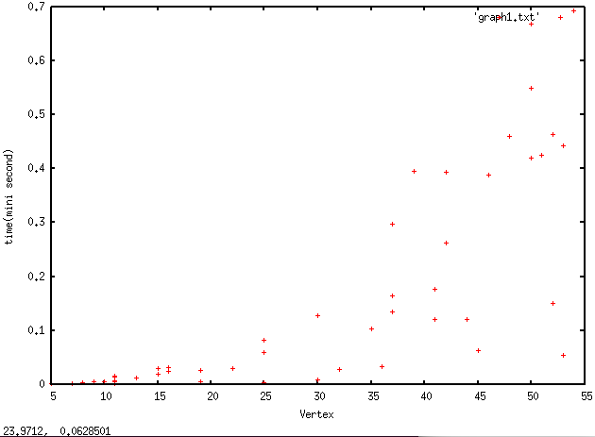
ANALYSIS
Fig. 4 : Analysis of time taken vs number of vertices for transformation of Incidence to Adjacency matrix.
Complexity :
N = Number of Vertex.
M = Number of Edges.
1. Best Case - O(N*M)
2. Worst Case - O(N*M)

Slide 5
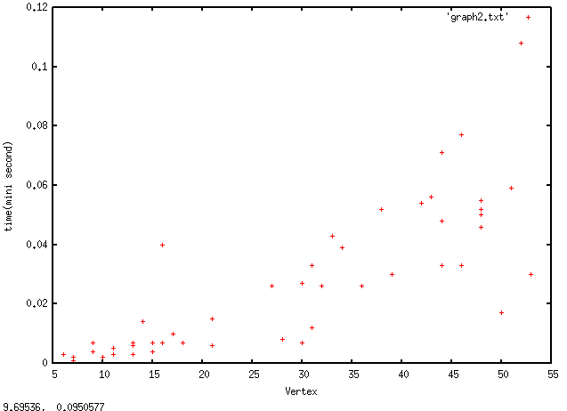
ANALYSIS
Fig. 5 : Analysis of time taken vs number of vertices for transformation of Adjacency to Incidence matrix.
Complexity :
N = Number of the Vertex.
1. Best Case - O(N*N).
2. Worst Case - O(N*N).

Slide 6
THANK YOU

